Slide 1
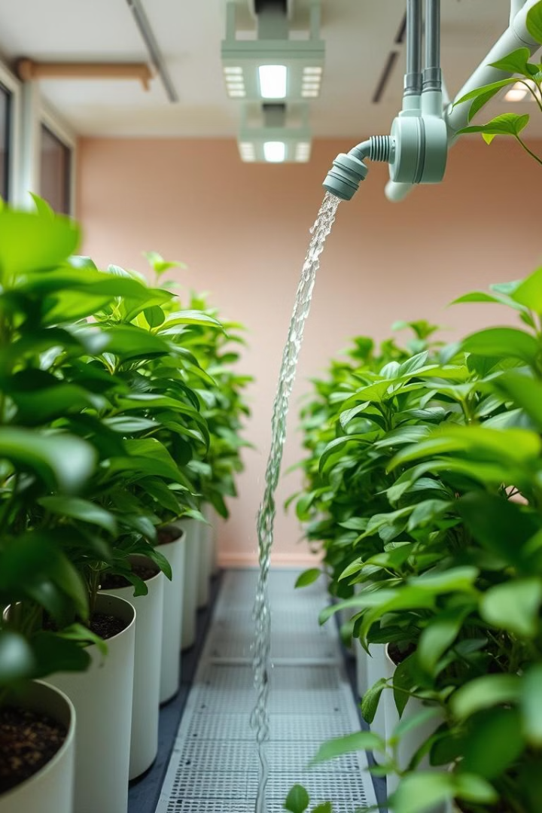

AUTOMATIC PLANT WATERING SYSTEM
USING ARDUINO NANO
TEJAS ANSH SHEKHER RITIK
UNDER SUPERVISION
OF
MR.SHAHJAD ASSIST.PROF
SCHOOL OF ENGINEERING AND TECHNOLOGY

Slide 2
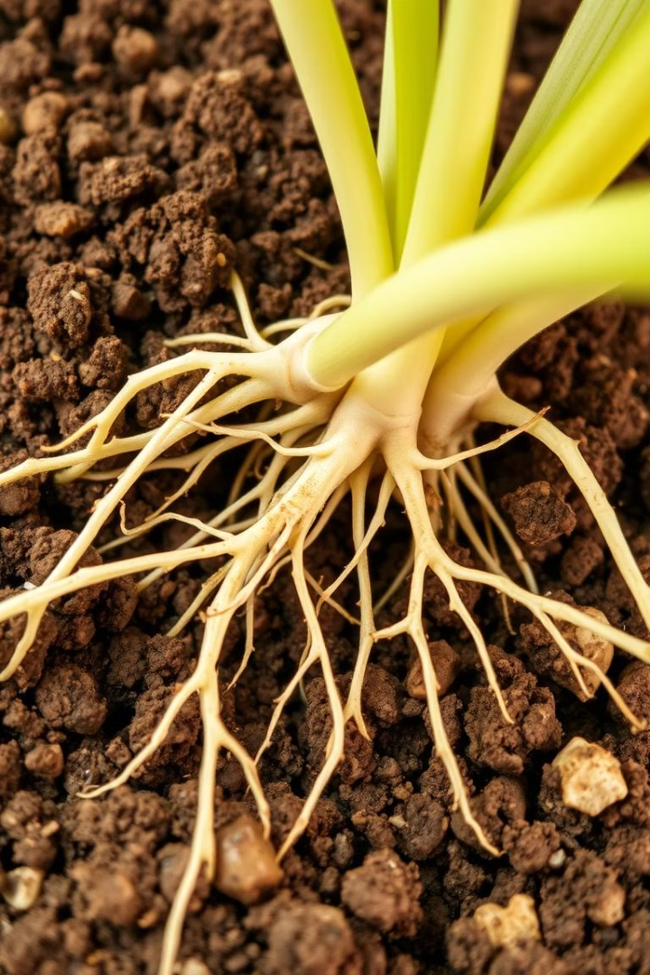
INDEX
INTRODUCTION
OBJECTIVES
ADDRESSING THE PROBLEM
SYSTEM COMPONENTS
WORKING PRINCIPLE
EXPECTED OUTCOMES
APPLICATIONS
FLOWCHART
CHALLENGES AND LIMITATIONS
CONCLUSION
REFERENCES

Slide 3

Automatic Plant Watering System
Efficient water use is crucial for plant growth. This system optimizes water usage by automating irrigation. It monitors soil moisture and supplies water as needed. This reduces human intervention and conserves water.
Notes:
1

Slide 4
Objectives of the System
1
Automated Watering
Water plants based on soil moisture levels.
2
Water Conservation
Prevent overwatering and underwatering.
3
Reduce Manual Labor
Minimize human intervention.
4
Enhance Plant Health
Improve irrigation efficiency.
Notes:
2

Slide 5
Addressing the Problem
Traditional Methods
Overwatering
Underwatering
Lead to water wastage and inefficient irrigation.
Can damage plant roots.
Reduces growth.
Notes:
3

Slide 6
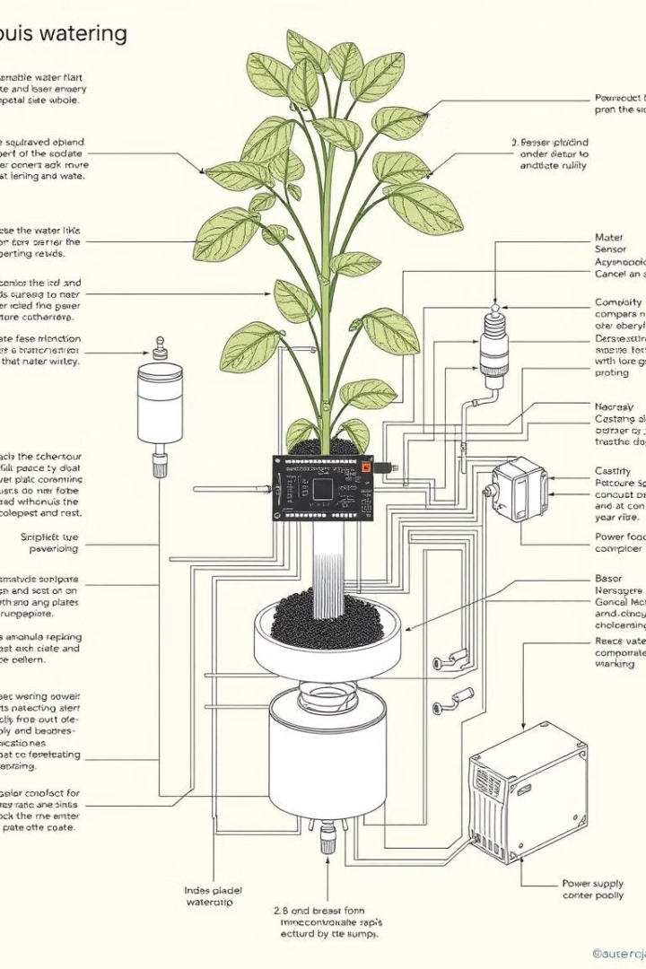




System Components
Soil Moisture Sensor
Microcontroller
Water Pump
Supplies water when needed.
Detects soil moisture levels.
Processes sensor data.
Power Supply
Provides system energy.
Notes:
4

Slide 7
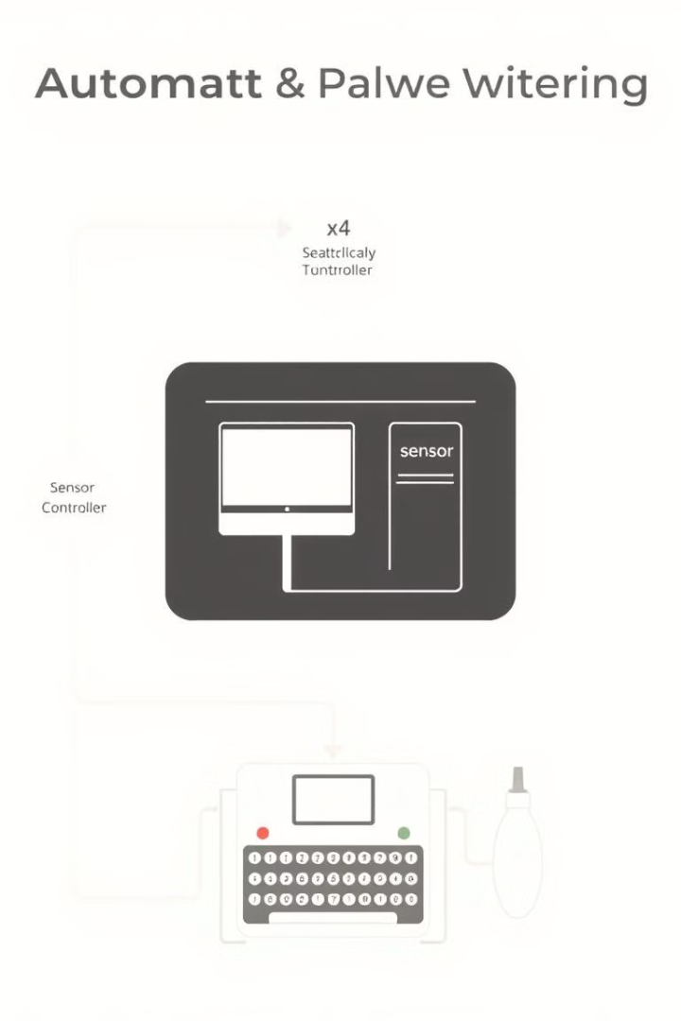
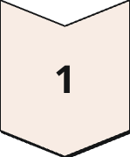
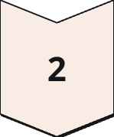
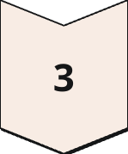
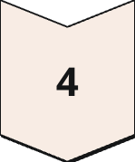
Working Principle
Measure Moisture
Sensor checks soil moisture.
Activate Pump
If low, pump turns on.
Adequate Moisture
Pump stops when moist.
Repeat Process
Ensuring optimal water.
Notes:
5

Slide 8
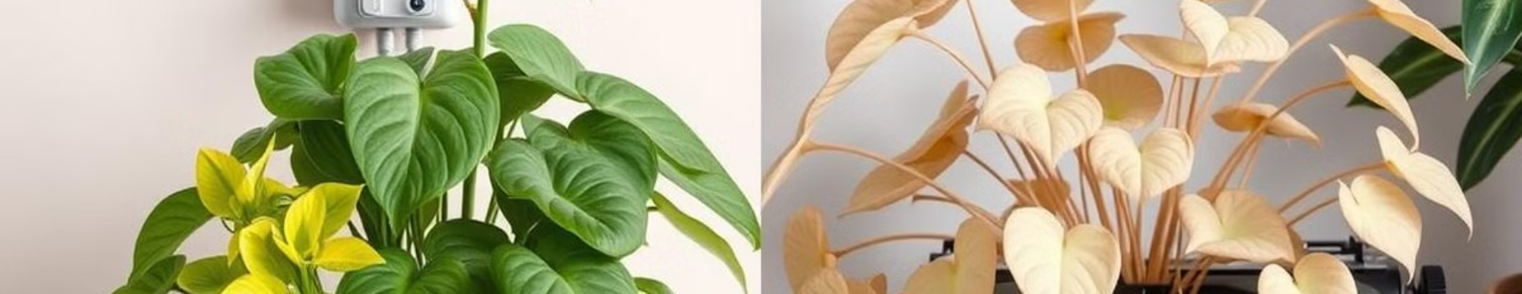
Expected Outcomes
Water Reduction
Improved Health
Optimize irrigation.
Adequate watering boosts plants.
Reduced Supervision
Cost Effective
Less human involvement.
Scalable solution.
Notes:
6

Slide 9
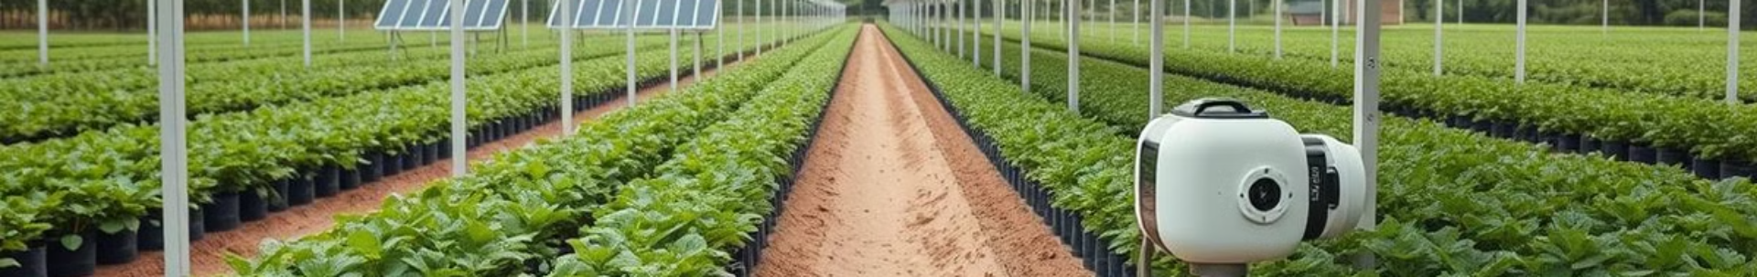
Applications
Home Gardening
1
Watering during absences.
2
Agriculture
Efficient farm irrigation.
Greenhouses
3
Controlled environments.
4
Urban Landscaping
Parks and gardens benefit.
Notes:
7

Slide 10
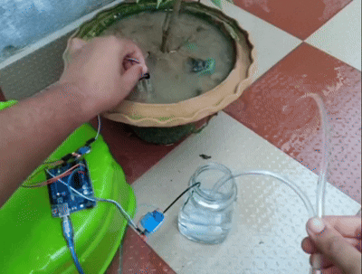
• Flowchart of Automatic Plant Watering System
. Start
↓
• Read Soil Moisture Level
↓
• Is Moisture Below Threshold?
/ \
Yes No
↓ ↓
•Turn ON • Keep Pump OFF
Water Pump
↓
• Check Again After Set Interval
↓
• End
Notes:
8

Slide 11
. Challenges and Limitations
• Initial setup cost may be high.
• Sensor accuracy can be affected by environmental factors.
• System maintenance is required for long-term performance.
• Dependence on electricity or batteries for continuous operation.
Notes:
9

Slide 12
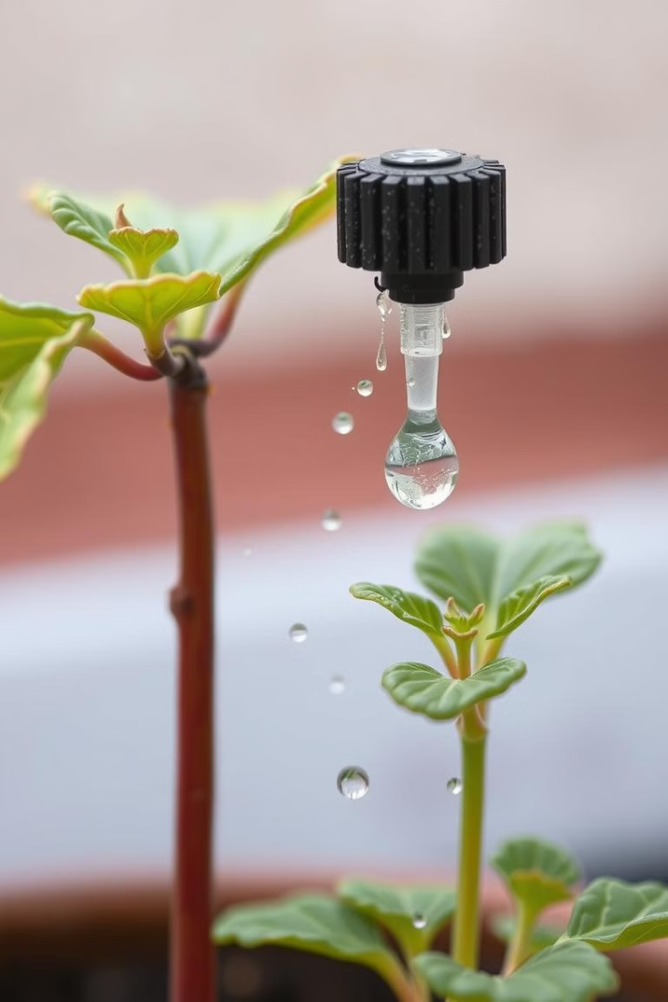
Conclusion
The Automatic Plant Watering System is efficient. It optimizes plant health and conserves water. With IoT, the system can improve large-scale agriculture.
Notes:
10

Slide 13
. References
• youtube video on smart irrigation techniques.
• Articles on water conservation in newspaper .
Notes:
11

